Slide 1
machine learning model Interpretability
Dan Ryan
August 2018 Palm Beach Data Science Meetup

Slide 2
What does “interpretability” mean?
“Interpretability is the degree to which a human can understand the cause of a decision.”
Tim Miller (2017) – “Explanation in Artificial Intelligence: Insights from the Social Sciences.”

Slide 3
When does interpretability matter?
Incomplete Problem Formulation
Safety
Privacy
Fairness / Avoiding Bias
Social Acceptance
Auditing and Debugging
Human-in-the-loop Decision Support
Human Learning (e.g. scientific insights)

Slide 4
regulatory considerations
Many industries have strict regulation that requires audit capability, privacy rules, and fairness constraints:
Law and Criminal Justice
Medicine
Finance
Transportation
Military / Security
Application of ML systems in these fields can be limited by the model’s ability to explain its decisions and actions to end users and provide an audit trail.

Slide 5
Complexity VS. interpretability trade-off
In general, there is a strong inverse correlation between the complexity/power of a model and its interpretability.
Larger amounts of data allow for more complex models without overfitting, but result in “black box” models.

Slide 6
From transparent to “black box”
Transparent
Decision Tree (Small)
Murky
Foggy
Support Vector Machines
Gaussian Processes
Black Box
Random Forest
Neural Networks
Linear Models
K-Nearest Neighbors
Markov Chains
Graphical Models (Bayes Nets)
Decision Tree (Large)
Gradient Boosting Machines
Decision Rules

Slide 7
A surge in interest
DARPA Explainable AI (XAI) Program Track
Interpretable ML Symposium at NIPS 2017
Fairness, Interpretability, and Explainability Workshops at ICML 2018
Many research groups across top AI labs in academia

Slide 8
What makes a “good explanation”?
Contrastive (what would happen if “X” were different?)
Selective (focus on one or at most a few factors)
Audience Appropriate (data scientist, auditor, customer)
Notices the Abnormal (presence of rare feature affecting output)
Generalizable (holds true for large parts of the input space)

Slide 9
Dimensions of interpretability
Inherent vs. Post-hoc
Can the model be examined directly for an interpretation (inherent), or does another method need to be applied to the trained model to extract an interpretation (post-hoc)?
Local vs. Global
Does the explanation apply to a single example or region (local), or to the entire dataset (global)?
Model Specific vs. Model Agnostic
Does this method only work on specific classes of models (specific), or to any type of model (agnostic)?

Slide 10
Global surrogate models
IDEA:
Given an already trained black box model, train an interpretable model (e.g. small decision tree) to mimic the output of the more complex model. Then use the surrogate model to generate explanations for the decisions of the black box model.
ADVANTAGES:
Easy to understand the process
Flexible as you can choose the type of surrogate model
DISADVANTAGES:
May not be possible to get a decent match between surrogate model and complex model.
Surrogate may fit well for some parts of input space, but not others.

Slide 11
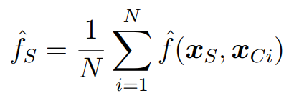
Partial dependence plots (pdp)
IDEA:
Choose 1 feature (or 2 for an interaction plot) and look at how different values for that feature affect the average value of the model output using values for the other features drawn from the input distribution.
ADVANTAGES:
Shows rough global effect for each feature across input range.
Can capture 2-variable interaction effects.
DISADVANTAGES:
Assumes that feature you are examining is independent from other features in the model.
Averaging output for each value of the feature can cancel out strong opposing effects.

Slide 12
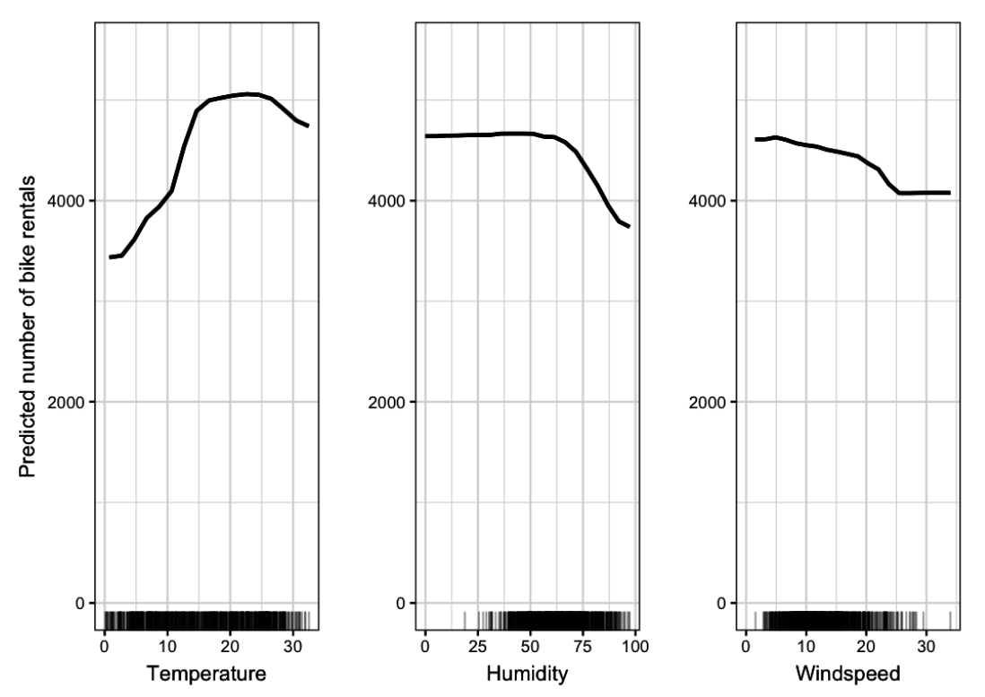
PDP Example

Slide 13
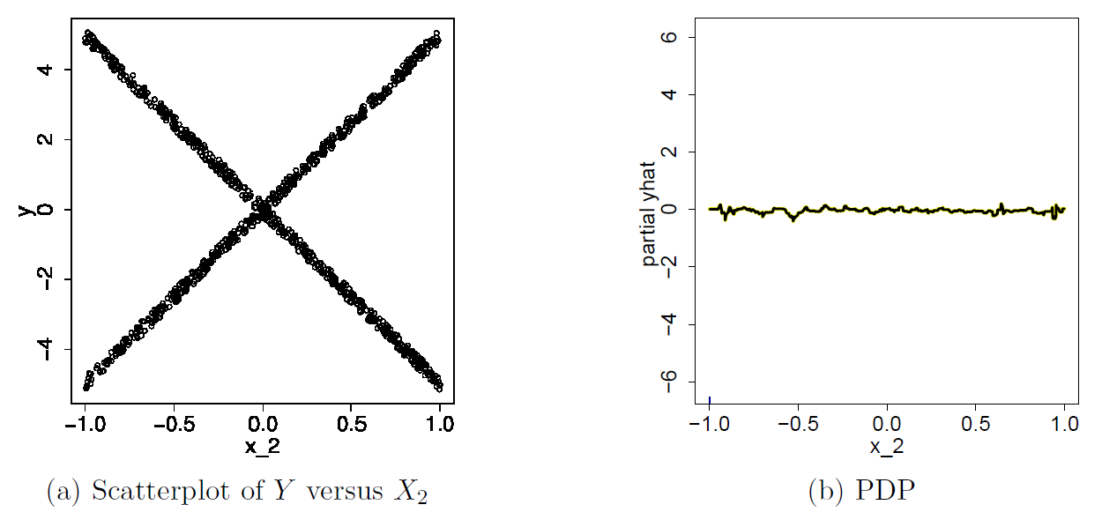
PDP Gone Wrong

Slide 14
Individual conditional expectation (ice)
IDEA:
Like PDP for 1 feature, except instead of averaging across all other features in the input space, plot a separate curve for each point in the input space and layer all of these curves on a single graph.
ADVANTAGES:
Avoids effects canceling each other out through the averaging operation.
DISADVANTAGES:
Can look very messy in some cases and not add much meaning.

Slide 15
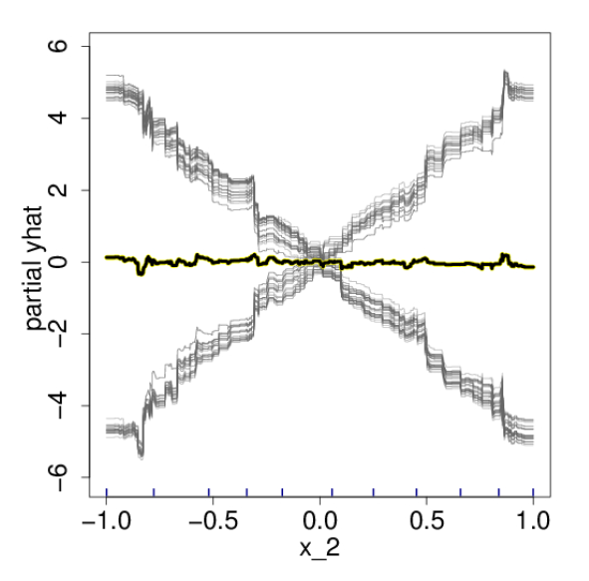
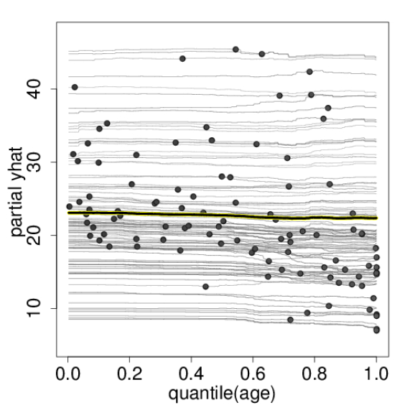
ICE ExampleS

Slide 16
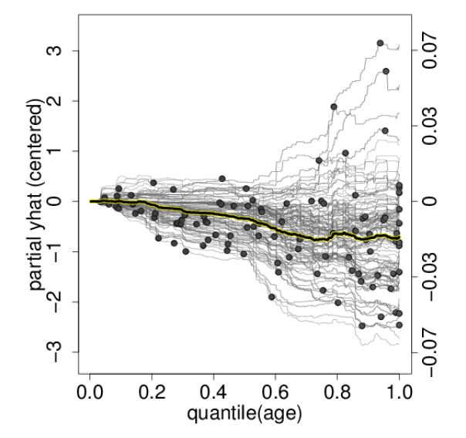
Centered ice (c-ice)

Slide 17
Feature importance
IDEA:
You can estimate how important a feature is to model performance (loss) by looking at the drop in performance when you randomly scramble that features values in the input space (keeping all else constant).
ADVANTAGES:
Model agnostic way to interpret global relevance of a feature to model performance.
Built into many ensemble decision tree models like random forest and gradient boosting machines.
DISADVANTAGES:
Does not tell you how the feature affects model output (just loss).
Is not always “consistent” (will explain during later discussion of Shapley Values).

Slide 18
Local feature importance
IDEA:
The same way you can look at a single instance with ICE as opposed to the average value in a PDP, you can look at what happens when you scramble an input feature for a single instance to get a local feature importance.
In other words, how does the model performance for this one example change when I scramble one of its features.
ADVANTAGES/DISADVANTAGES:
Same as the global feature importance case.

Slide 19
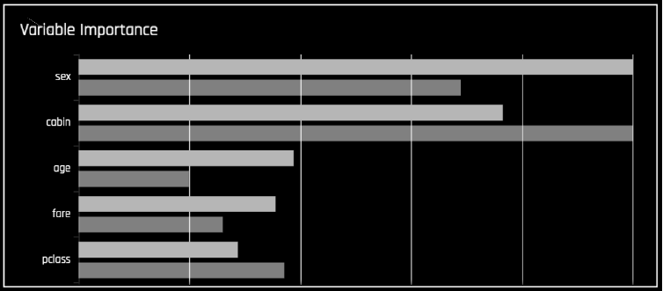
Feature importance example

Slide 20
Local surrogate models
IDEA:
To interpret the main model at a single input instance, fit an interpretable model that matches the main model in the region around the input instance and use that model to explain the prediction.
ADVANTAGES:
Higher fidelity explanations than using the global surrogate (easier to be right locally than globally).
DISADVANTAGES:
Only local explanations.
Have to fit many surrogate models.
Can be sensitive to how you measure distance (locality) in input space.

Slide 21
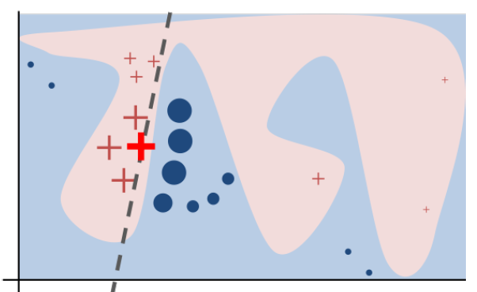
LIME
Locally Interpretable Model-agnostic Explanations:
Sample points from the input space and weight them by proximity to example you are trying to explain (or synthesize nearby data).
Fit a sparse linear model to this data trying to predict the main model output.
Use this newly fit sparse linear to explain the main model.

Slide 22
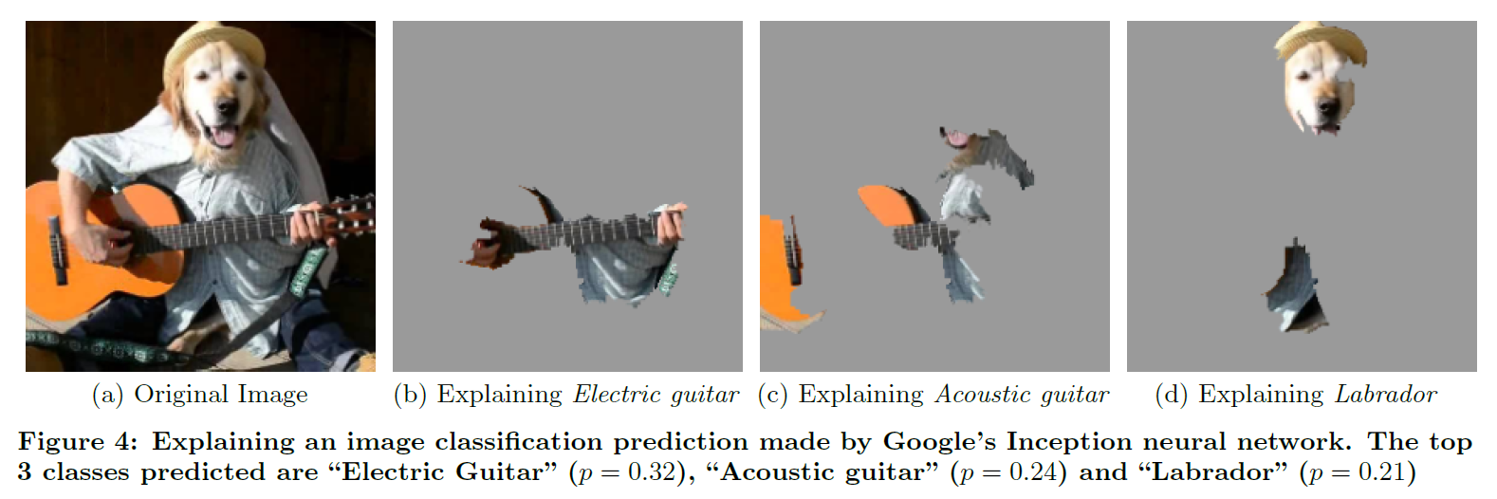
Lime for images

Slide 23
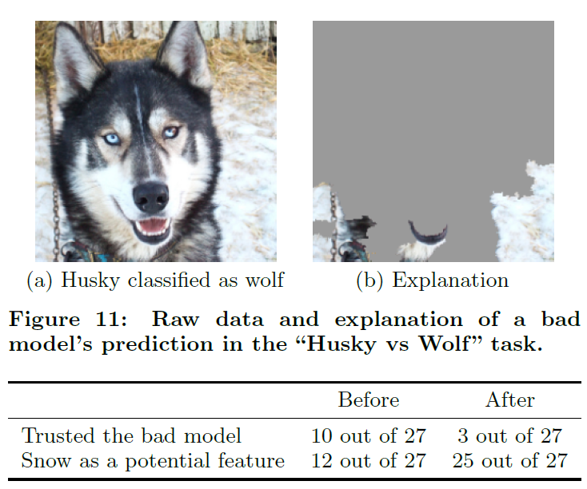
Model debugging with lime

Slide 24
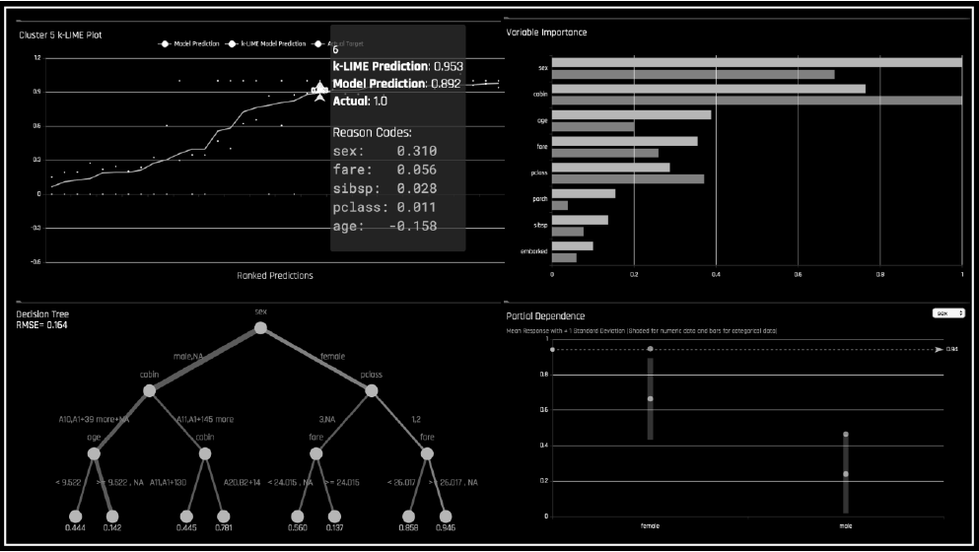
H2o Driverless ai - MLI

Slide 25
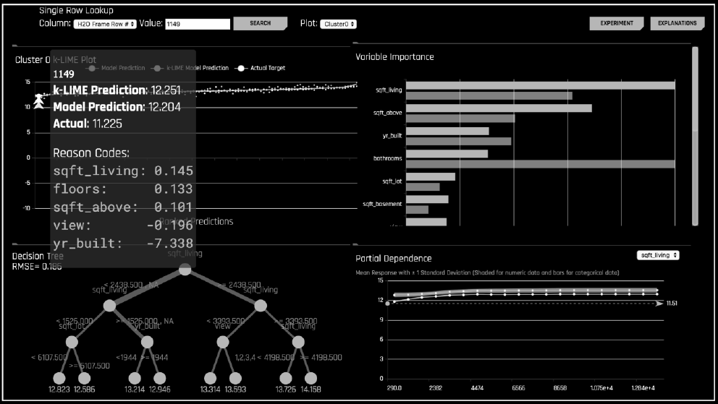
H2o Driverless ai - MLI

Slide 26

Sharing a taxi (Feature attribution)
Suppose 3 friends are going to share a cab home from their local data science meetup one night. They all live along the same street but different distances. How should they split up the bill?
AL $5
BOB $15
COREY $20
ORDER | AL | BOB | COREY
(A, B, C) | $5 | $10 | $5
(A, C, B) | $5 | $0 | $15
(B, A, C) | $0 | $15 | $5
(B, C, A) | $0 | $15 | $5
(C, A, B) | $0 | $0 | $20
(C, B, A) | $0 | $0 | $20
SUM | $10 | $40 | $70
SHARE | $1.67 | $6.67 | $11.67

Slide 27
Shapley values
IDEA:
The only way for an additive feature attribution method to maintain some desirable characteristics (including local accuracy and consistency) is to assign feature attributions using Shapley Values. So, use those!
ADVANTAGES:
It gives you the right answer.
DISADVANTAGE:
Computational complexity (sum over all permutations).

Slide 28
Tree shap
Amazing algorithm developed by same group that discovered original Shapley Value approximation methods.
Can compute exact Shapley Values for tree ensemble models in a very short amount of time (instead of exponential in number of features).
Bonus: it can compute interaction effects (Shapley interaction index) as well!
Double bonus: awesome software package with killer visualizations.

Slide 29
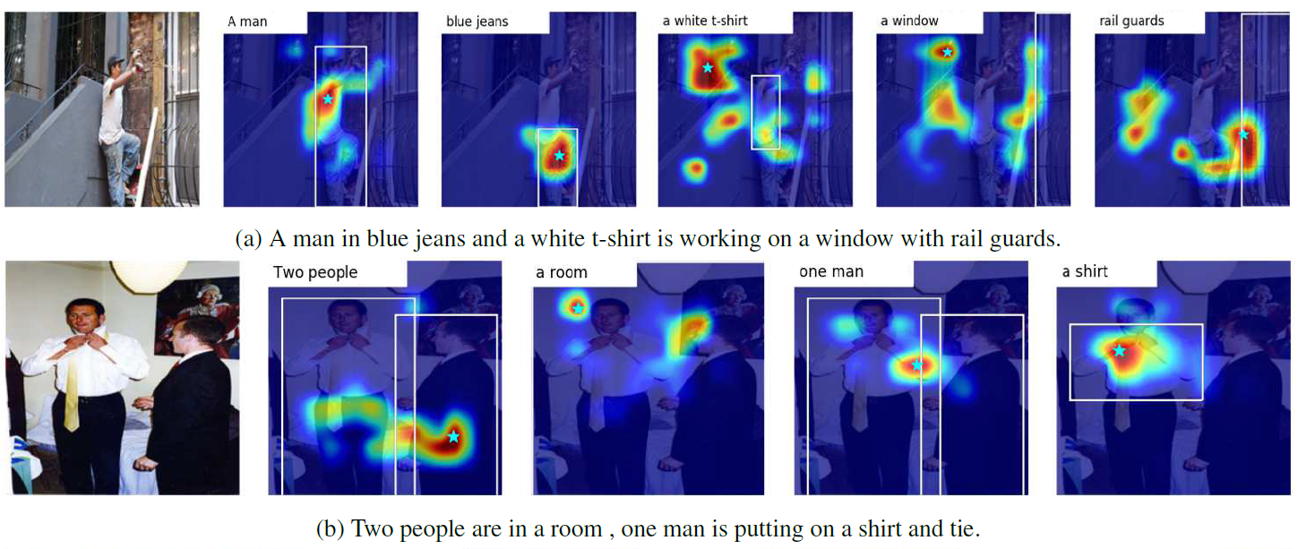
Top down visual saliency guided by captions

